Slide 1
Making Herbarium Labels
Or
How to Make Your Herbarium Curator Happy!

Slide 2
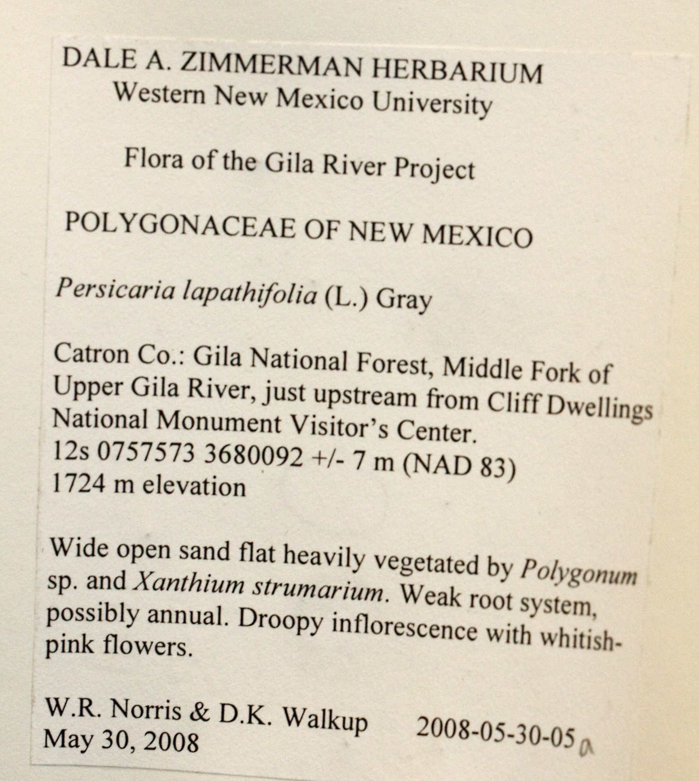

Slide 3
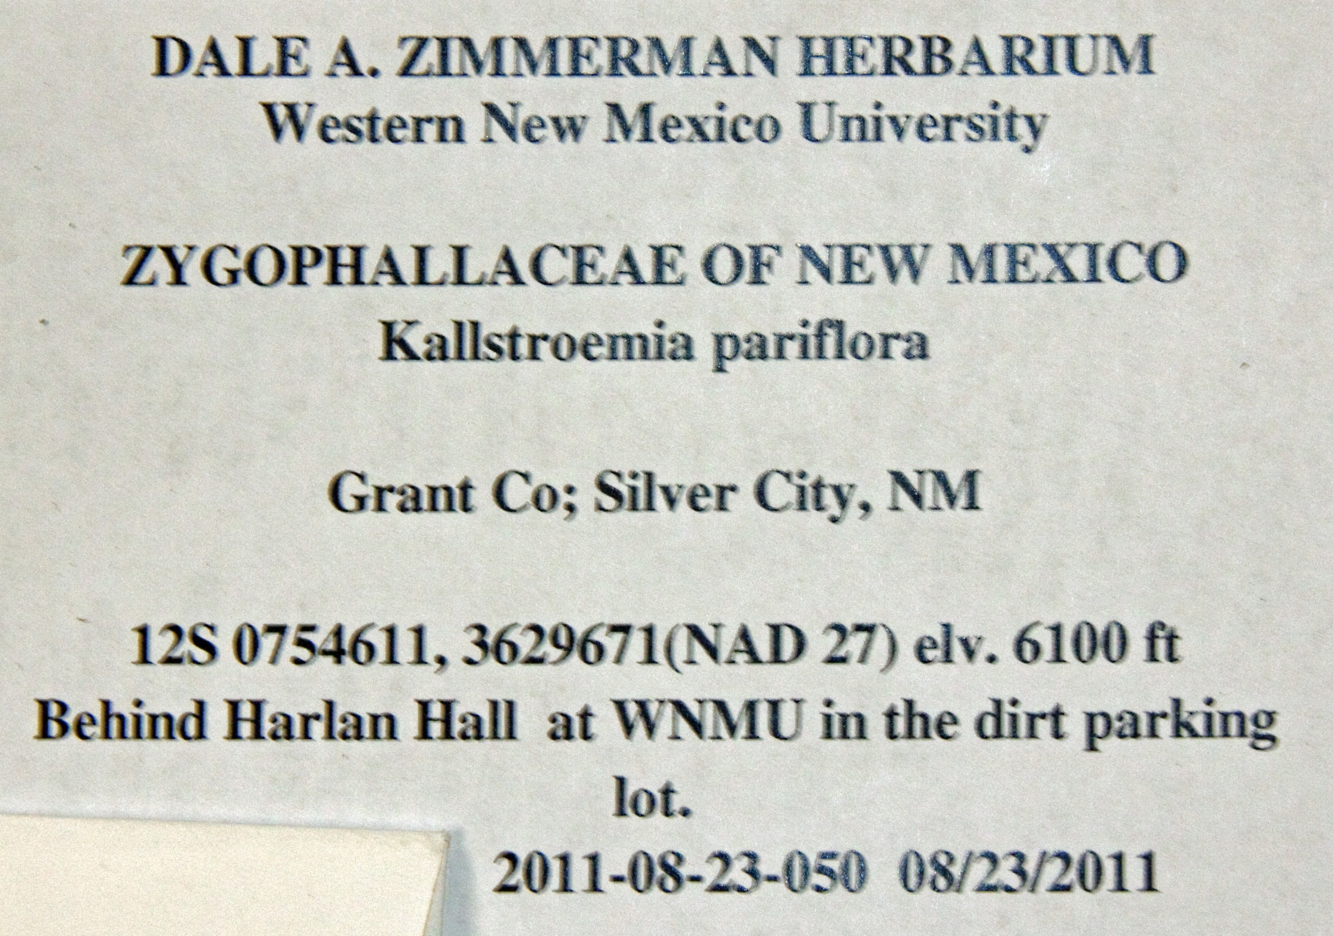
No authority
Corolla color? Fruit character?

Slide 4
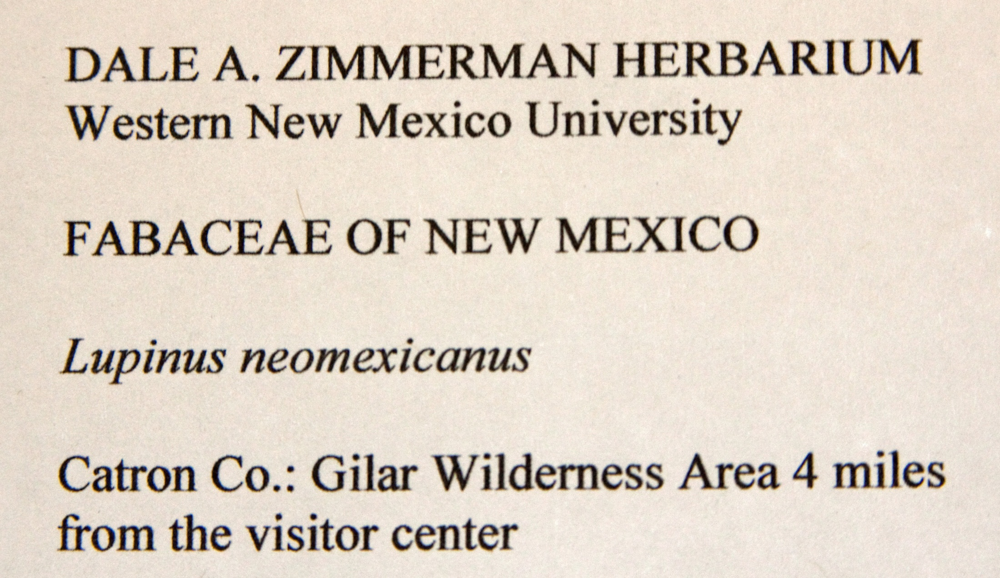
Center WNMU
Center
No authority
Corolla color, better locale data, etc.
No collector’s name, collection number or date

Slide 5
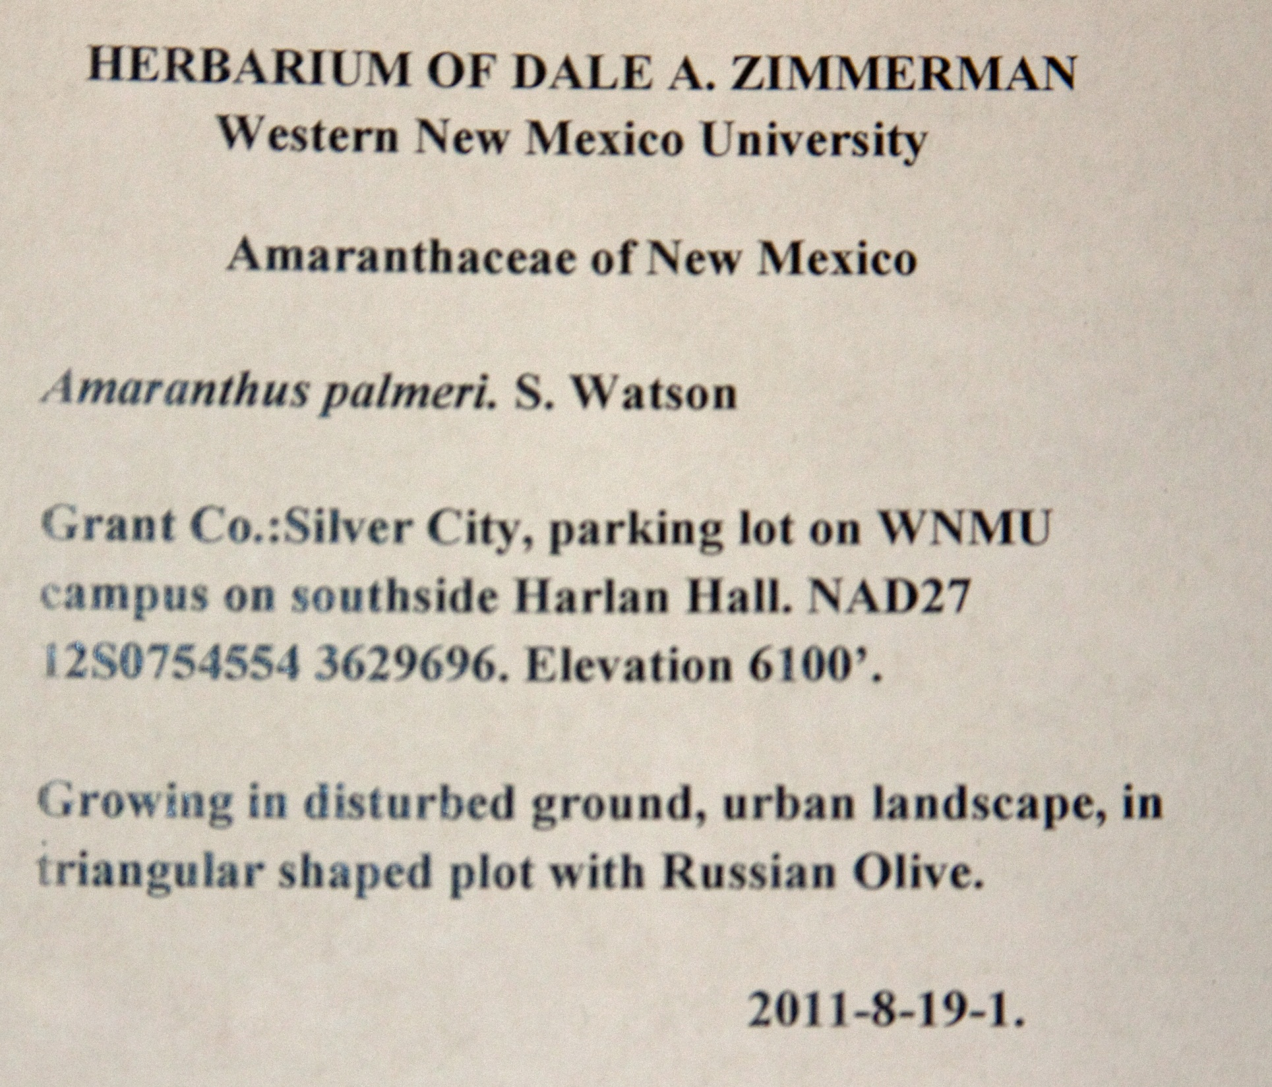
Need description of plant/corolla etc.
Need date in spite of collection number looking like date.

Slide 6
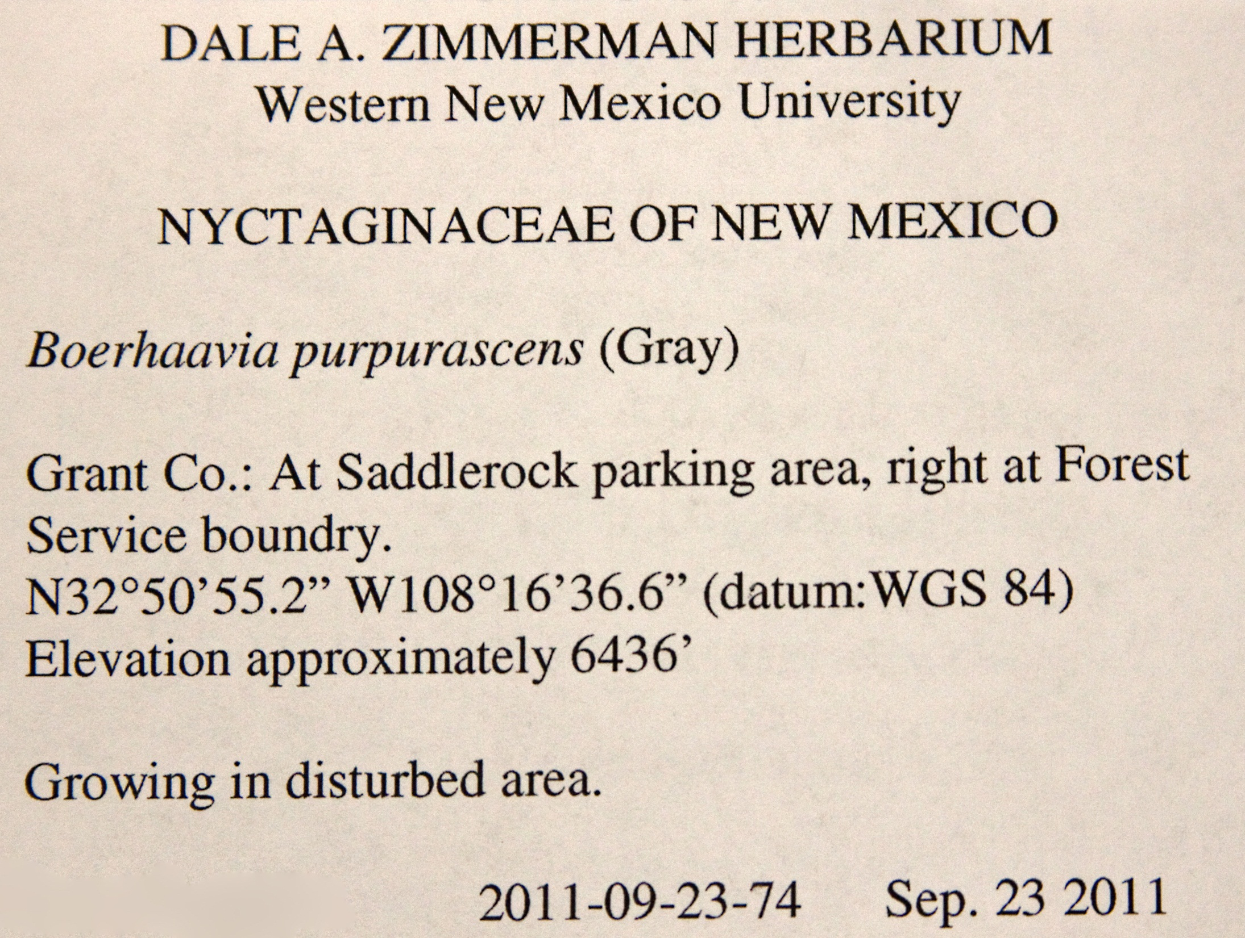
No parentheses around uncomplicated authority
Plant description– corolla color, surrounding veg, etc.

Slide 7
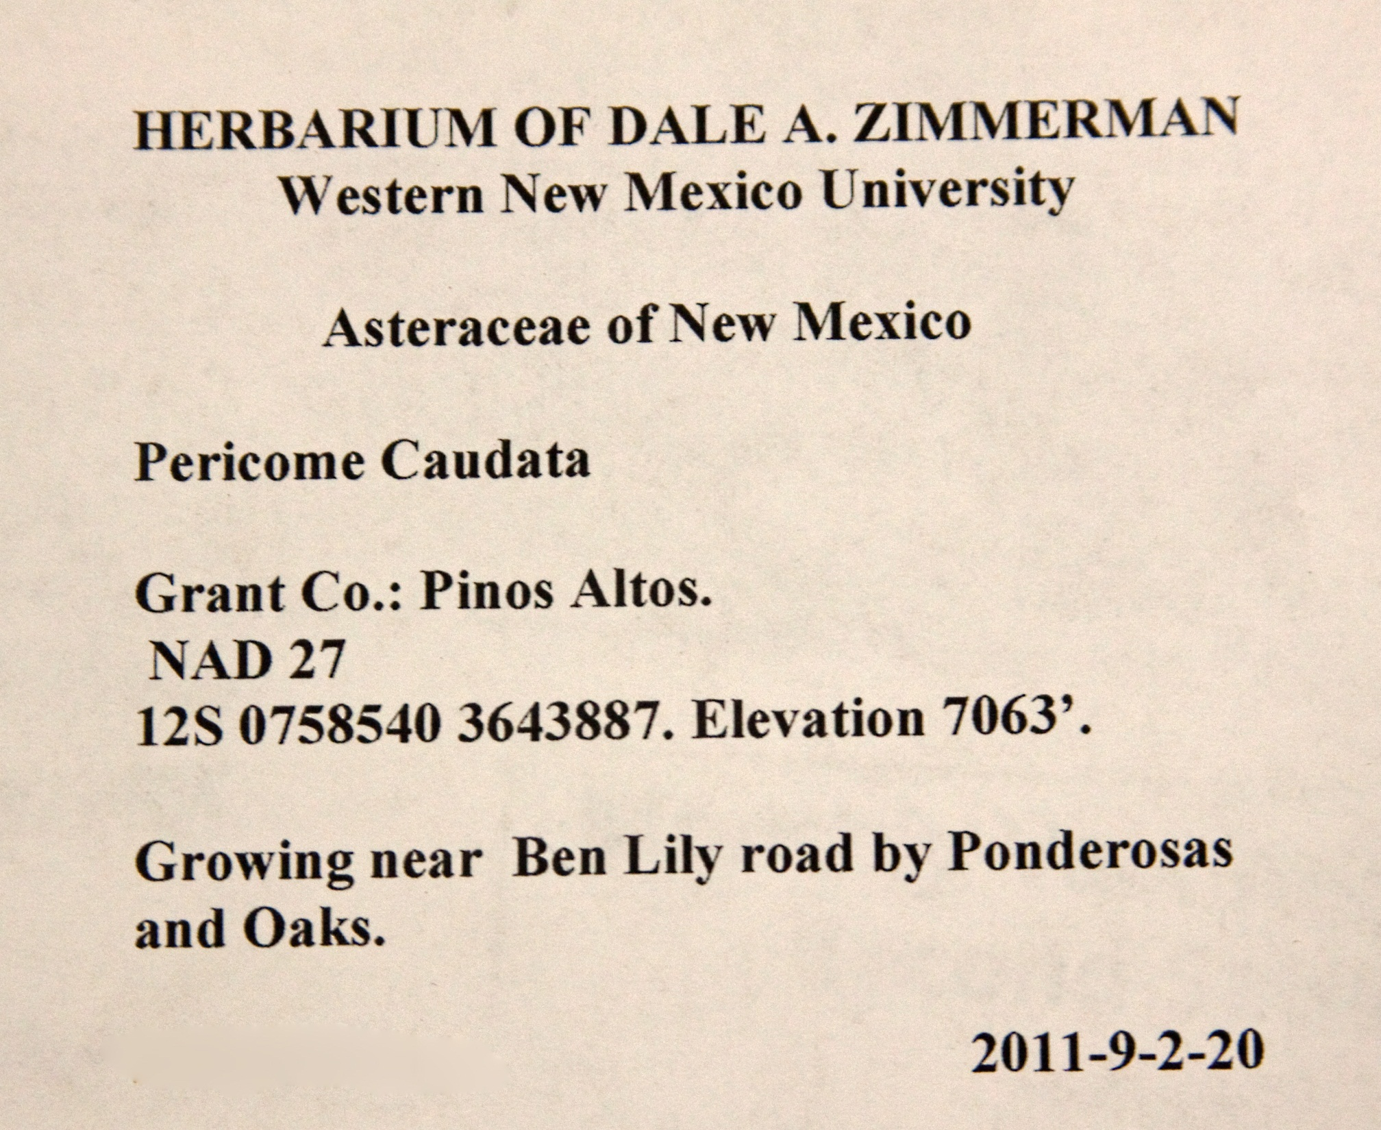
Authority?
Need better location description
No line break
Hwy 15?
Needs plant description/corolla color
Needs date

Slide 8
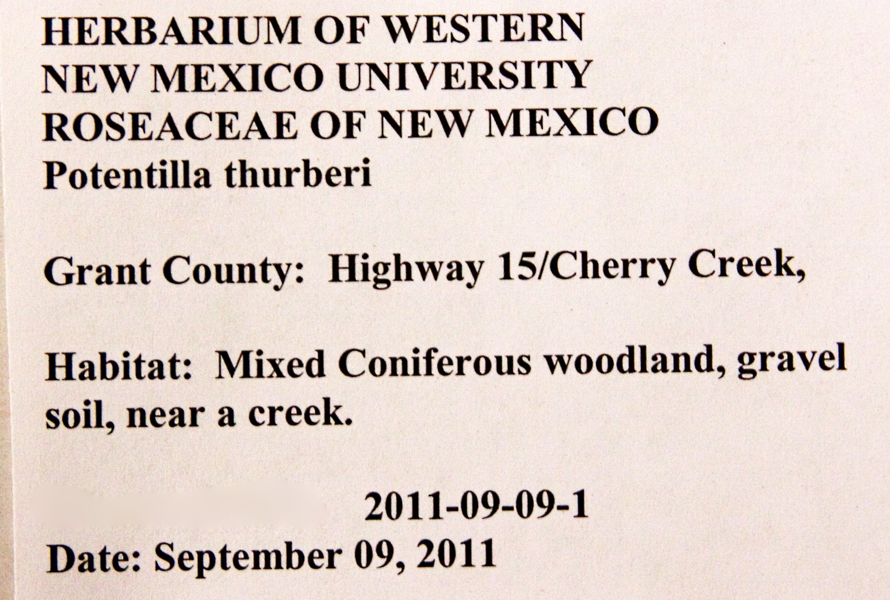
Dale A. Zimmerman Herbarium (one line, centered)
Western New Mexico University smaller, centered
Authority?
Smaller, centered
No line break, where along creek, the campground, elsewhere?
Plant description, velvety red corolla, etc.
Omit date: just put the date

Slide 9
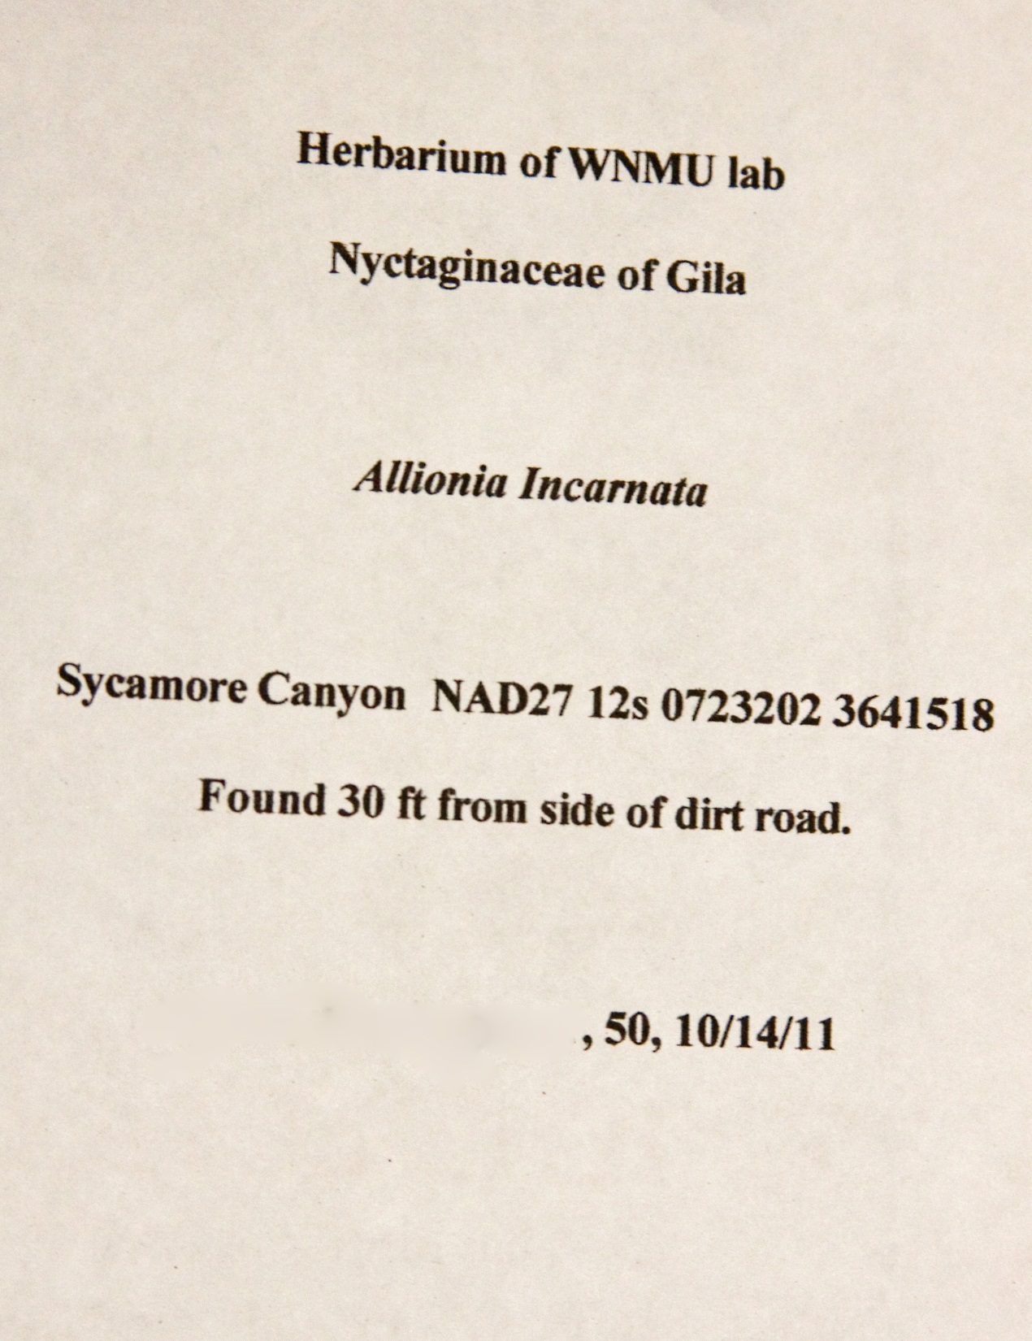
Center: Dale A. Zimmerman Herbarium
Center (smaller): Western New Mexico University
See handout for exact amount of space, but this is way too much!
--- of New Mexico
Do not capitalize species, just genus, and needs authority
Single space, justify left, and add where in Sycamore Canyon and plant descriptions.
Improper date and collection number format

Slide 10
Refer to the properly done labels in the herbarium or the first one in this presentation as well as to the written instructions on how to make labels! The label is worth half the collection point total!

